Slide 1
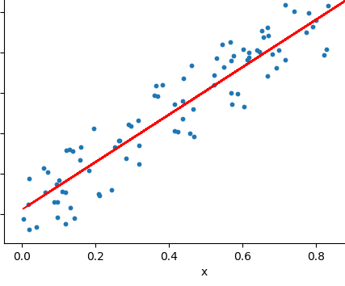
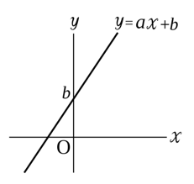
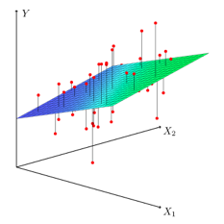
Linear Regression
Simple Linear Regression – draw straight line through data points.
In other words, find slope "a" and intercept "b"
so that the line y = ax + b matches the data.
More complex case:
Multidimensional Linear Regression

Slide 2
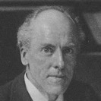
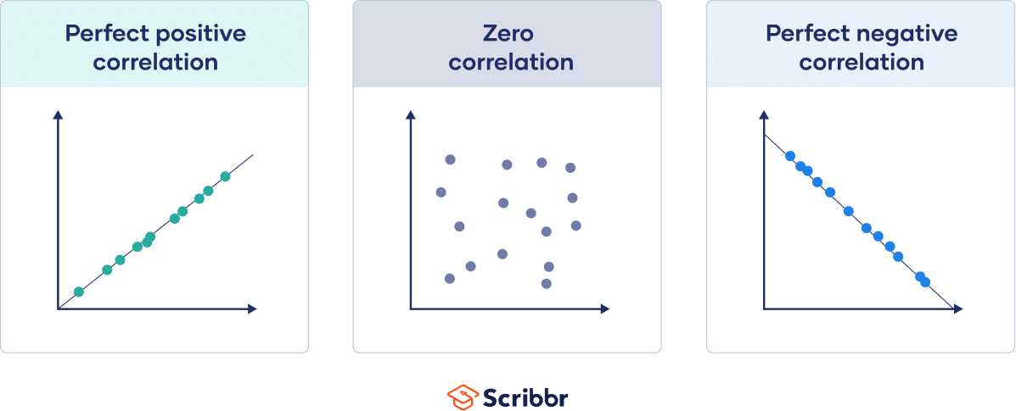
Correlation and Regression
Pearson Correlation r
https://en.wikipedia.org/wiki/Pearson_correlation_coefficient
Karl Pearson (1857 - 1936)
Famous English
mathematician
and biostatistician
SS = Sum of Squares
SP = Sum of Products
r = 1
r = 0
r = -1
Pearson correlation is also known under names:
Pearson correlation coefficient (PCC)
Pearson's r
Pearson product-moment correlation coefficient (PPMCC)
Bivariate correlation
r can vary from -1 to 1:
-1 – perfect negative correlation
+1 – perfect positive correlation
R² is the square of the Pearson's correlation coefficient r (for a single regressor, fitted by least squares)

Slide 3
Linear Regression
When drawing a curve through experimental points,
it is very important to estimate how good this curve
fits the data, and if fitting the data with this curve makes sense.
For this you can use the Coefficient of Determination R²: – https://en.wikipedia.org/wiki/Coefficient_of_determination
“R squared” is a number between 0 and 1. R² close to 1 – good model.
R² = r² (the square of the Pearson's correlation coefficient r (for a single regressor, fitted by least squares)
Linear Regression = draw a line through experimental points.
- https://en.wikipedia.org/wiki/Linear_regression
- https://en.wikipedia.org/wiki/Simple_linear_regression
- https://paternogbc.shinyapps.io/SS_regression/ - play with it
We derive linear model by minimization the mean square error (MSE):
We take partial derivatives by two coefficients - and solve system of 2 equations, and after some algebraic transformations, we derive the standard OLS method (OLS = Ordinary Least Squares).
y_{m} = y_{mean} = sum(y)/N var(x) = variance(x) = sum((x-x_{m})²)
x_{m} = x_{mean} = sum(x)/N covar(x,y) = covariance(x,y) = sum((y-y_{m})*(x-x_{m}))
slope b₁ = covar(x,y) / var(x)
intercept b₀ = y_{m} - b₁*x_{m}
Standard Error of regression slope:
where:
SS = Sum of Squared
RES – residual errors = diffs between model and points)
TOT – total, diffs between mean and points
y_bar – mean
y_hat – model
=

Slide 4
Linear Regression - assumptions
Linearity: The relationship between X and the mean of Y is linear.
Normality: For any fixed value of X, Y is normally distributed. We presume that deviations ϵ_{i} are picked from normal distribution. From this follows that the sampling distributions of slope and intercept (b₁ & b₀) are also normally distributed. Note: even if the ϵ_{i} are not Normally distributed, a general form of the central limit theorem tells us that the distributions of slope and intercept will be approximately normal if number "n" is big enough.
Independence: Observations are independent of each other. We assume that our sample is a SRS (simple random sample) of size "n". This means that it consists of "n" points chosen from the population in such a way that every set of n individuals has an equal chance to be the sample actually selected.
Homoscedasticity: The variance of residual is the same for any value of X.
Homoscedasticity
Linearity, normality, same deviation ( same σ )
Heteroscedasticity
Variance changes
Autocorrelation
Observations are NOT independent
4 sets of points
fit by the same line

Slide 5
Linear Regression – Slope Error
2σ_{ε}
We do not know real population σ, we use the estimated model standard deviation s.
When we do this, we move from the Normal distribution to t-distributions with degrees of freedom n – 2 .
ϵ_{i} are Normally distributed with standard error σ. "x" is distributed uniformly ?
The error of the slope is calculated as:
A confidence interval for the slope β1 is
b1 ± t * SE_{b1}
In this expression, t is the value for the t-distribution density curve with (n – 2) degrees of freedom with area between [ −t, t ].
To test the hypothesis H0: β1 = 0,
compute the test statistic :
Note: even if the ϵ_{i} are not Normally distributed, a general form of the central limit theorem tells us that the distributions of slope and intercept will be approximately Normal if number "n" is big enough.
Example: 42 points, df= n-2 = 40.
Looking for a critical value in t-test table for df=40, P=0.05, two-tails combined: cv = 2.021
Then if slope b1=35, error SEb1=10,
then t = 35/10 = 3.5 >> 2.021, so we reject the null hypothesis that slope = 0

Slide 6
Linear Regression – Slope Error via "r"
Standard Error of regression slope:
= ...
where sd(...) is standard deviation, and r – correlation coefficient.
https://stats.stackexchange.com/questions/342632/how-to-understand-se-of-regression-slope-equation/342672
https://www.slideserve.com/karis/introduction-to-linear-regression-and-correlation-analysis
df = degrees of freedom = n-2
If we have 2 points – we can draw only
one line, no freedom, df = 0. As we add points – we get more freedom.

Slide 7
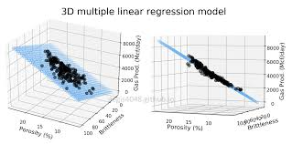
Multidimensional Linear Regression (MLR)
(a.k.a. Multiple Linear Regression)
Some people recommend to preprocess data:
center variables to their mean values
scale
Others argue that this doesn't improve the model.
- https://stats.stackexchange.com/questions/29781/when-conducting-multiple-regression-when-should-you-center-your-predictor-varia
Centering:
If you center the variables so that the predictors have mean 0,
it makes it easier to interpret the intercept term as the expected value of Yi
Scaling:
If you scale variables to be close, it is easier to read computer output
and compare the coeffitients.
Note that centering/scaling does not affect your statistical inference.
The P-values will be the same.
Other benefits of centering/scaling:
- when creating a composite feature
- when using PCA (Principal Component Analysis)
- creating power terms (X2, ...) or interaction terms
- the convergence is faster if using Gradient Descent
- algorithmic stability (especially when using power terms)

Slide 8
Multicollinearity
Detect Multicollinearity
Pair-wise correlations
Variance Inflation Factors VIF = 1/( 1 - R²_{k} )
Multicollinearity - one predictor variable can be linearly predicted from the others with a substantial degree of accuracy.
Example:
Lawyer salary = B₀ + B₁(Years Experience) + B₂(Age) + e
In this situation, the coefficient estimates of the multiple regression may change erratically in response to small changes in the model or the data.
The standard error of determining coefficients can grow significantly, and P-values of correlated variables can grow big.
It looks like correlated predictors fight/compete with each other.
!
If two variables are perfectly collinear,
the training fails with error.
Multicollinearity does not reduce the predictive power or reliability of the model as a whole, at least within the sample data set; it only affects calculations regarding individual predictors.

Slide 9
Remedies to Multicollinearity problem.
Leave the model as is, despite multicollinearity. It will still work well as a predictor
Try dropping one of the variables – see if coefficients for others will change
Combine the correlated variables
Do not add dummy variables which could cause multicollinearity
Try subsets of training data – watch how stable the coefficients are
Get more data – thus get better estimates
Mean-center the predictor variables. Generating polynomial terms or interaction terms can cause some multicollinearity otherwise
Standardize your independent variables
It has also been suggested that using the Shapley value, a game theory tool, the model could account for the effects of multicollinearity
Ridge regression or principal component regression or partial least squares regression can be used
If the correlated explanators are different lagged values of the same underlying explanator, then a distributed lag technique can be used, imposing a general structure on the relative values of the coefficients to be estimated

Slide 10
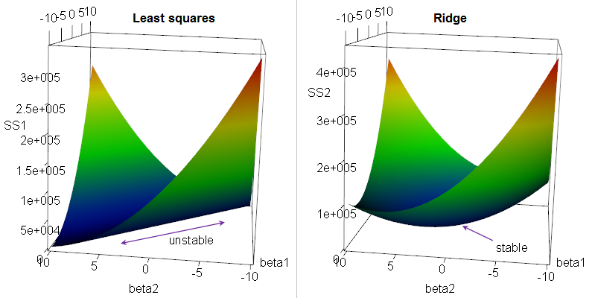
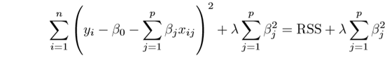
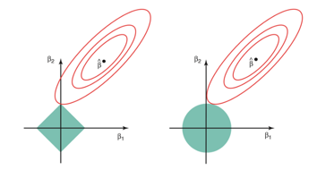
Regression: Ridge, LASSO, Elastic Net
Multivariate (multiple) Linear Regression Regularization.
Suppose we have a OLS (Ordinary Linear Squared) regression
where two parameters x1 & x2 are not orthogonal, but in fact highly correlated.
Then there may be is infinite number of coefficients which will fit the model.
For example, (x1 - x2), (10*x1 - 10*x2), (100*x1 - 100*x2), etc.
If we are trying to minimize the cost function in the multidimensional
space of coefficients, we will get an infinite diagonal groove (ridge) for x1=x2.
Any place at the bottom of this ridge is equally good for us.
So we will get a big variability in possible values of coefficients for x1 & x2.
The solution will be unstable.
We can reduce this variability by adding additional regularization factor like this:
Why Ridge Regression is called Ridge ...
When we minimizing this expression, bigger "lambda" value will cause smaller "beta" values, thus keeping the coefficients "beta" from becoming too large.
This is called "Ridge Regression". It changes the infinitely long ridge into a local minimum.
In Ridge Regression we add a "regularization" term as sum of squares (L2 norm).
In LASSO Regression we use L1 norm (sum of abs values),
where LASSO = Least Absolute Shrinkage and Selection Operator.
LASSO favors solutions on the tips of the bounding surface for coefficients, where some of coefficients are zero. Thus it favors "sparse" solutions.
A combination of Ridge and LASSO Regressions is called "Elastic Net"
Why LASSO favors sparse solutions

Slide 11
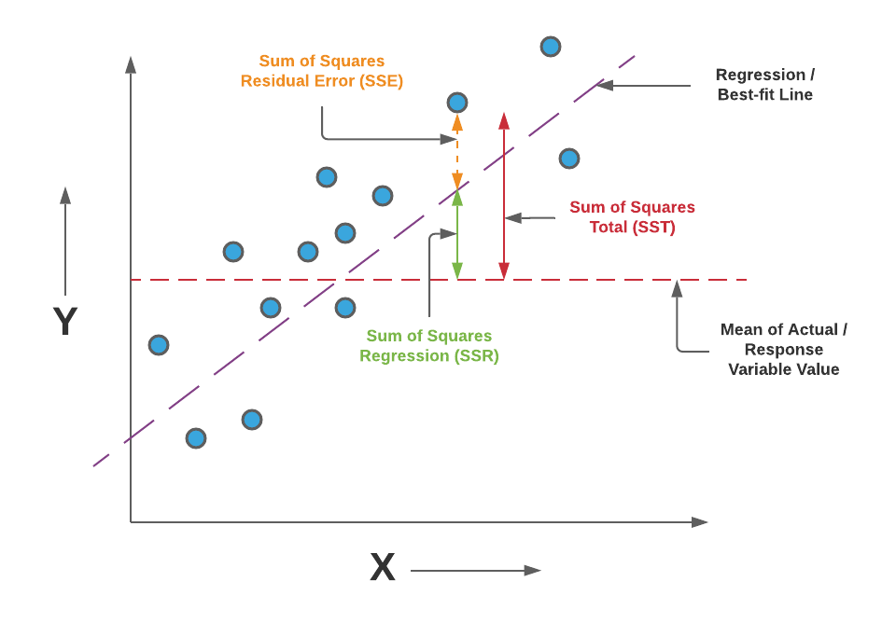
SST = SSR + SSE
Actual minus H_{o}
Model minus H_{o}
Actual minus Model
Null hypothesis H_{o}:
no slope (horizontal model)

Slide 12
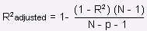
Linear Regression Output
F-test of the overall significance and its P value.
F-test can assess multiple coefficients simultaneously
(unlike the t-test which can assess only one regression coefficient at a time).
F-test compares a null hypothesis H₀
("restricted" model with no slope predictors (zeros),
intercept-only model = b0 horizontal line)
to the "unrestricted" model with predictors (b₁, ... b_{p}),
where N=25 – number of points, p=3 - number of regression parameters.
SSR / p explained variation 146.425
F = --------------- = --------------------- = -------- = 3.22
SSE / (N-p-1) unexplained variation 45.451
Example from "zedstatistics" channel
"Regression Output Explained"
https://www.youtube.com/watch?v=VvlqA-iO2HA
Note Confusion about "R":
SSR = SS for Regression Model
SSE = SS for Residual
ANOVA Section (top left of output)
SS = Sum of Squares differences:
Model SS = SSR = diff(H_{o} , model)
Residual SS = SSE = diff(actual, model)
Total SS = SST = SSR + SSE = diff(actual, H_{o})
df - degrees of freedom (in model or in number of variables)
MS – Mean Squares divided by respective df
T-values – if large, it means that the coefficient is significant
F-value – if large, it means that at least one coefficient is significant
(rejecting the zero-slope null hypothesis)
Here we have an interesting case: the high F-value means statistical significance, but the low R² means high variability unexplained by the model
Reject Null Hypothesis
b₁ = b₂ = b₃ = 0
Reject H_{o}
Generally a random variate of the F-distribution
X = (U₁/d₁) / (U₂/d₂)
where U₁ and U₂ are independent
and have chi-squared distributions
with d₁ & d₂ degrees of freedom respectively
Constant
Term

Slide 13
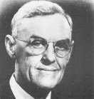
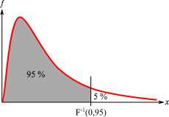
F-distribution – used in F-test of the overall significance
right-skewed distribution used most commonly in ANOVA (Analysis of Variance). - https://en.wikipedia.org/wiki/F-distribution
named after Ronald Fisher and George W. Snedecor
George W. Snedecor
1881-1974, USA
F-tests:
We have two "populations" of data with normal distributions. Our Null hypothesis is that their variances are equal.
We calculate the F-value and look where it lands on the appropriate F-distribution to see whether it is significantly incompatible with this null hypothesis.
Ronald Fisher 1890-1962
British. Developed the analysis of variance ANOVA
A random variate of the F-distribution is a ratio:
F = Variance1 / Variance2 = (U₁/d₁) / (U₂/d₂)
where U₁ and U₂ are independent and have chi-squared distributions
with d₁ & d₂ degrees of freedom respectively.
If d1=d2=1000, the ratio looks like normal with peak ~1.
If numbers are smaller and not-equal – we get skewed shapes.
Critical Value
Accept H₀
Reject H₀

Slide 14
Linear Regression for Categorical Values
Original Data
Basic Idea:
Use one-hot encoding to convert
categorical variable(s) to numeric.
One-Hot Encoded data
import os, sys, io
import pandas as pd
import numpy as np
import statsmodels.api as sm
import sklearn
from sklearn.linear_model import LinearRegression
import matplotlib.pyplot as plt
# .......
est = sm.OLS(y_trainplusvalid, X2)
est2 = est.fit()
print(est2.summary())
See all code here:
- https://github.com/lselector/notebooks/blob/master/Time_Series_Forecast_Multiple_Linear_Regression.ipynb

Slide 15
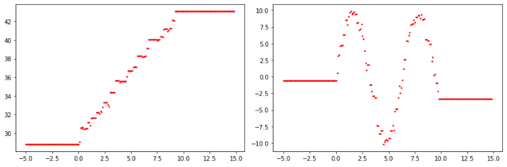
Regression - Handle Missing Values (nulls)
Most linear regression algorithms can not handle missing values.
So you need either remove rows or columns with nulls from training data, or fill nulls with some reasonable values.
For example:
df.fillna(df.mean(), inplace=True)
df.fillna(df.median(), inplace=True)
myval = df['salary'].mode()[0]
df['salary'] = df['salary'].fillna(myval)
from sklearn.preprocessing import Imputer
imputer = Imputer()
y_imputed = imputer.fit_transform(y)
The word "regression" is mostly associated with linear regression, more specifically with OLS (Ordinary Least Squares).
Sometimes with Ridge Regression - a version of linear regression which is used to analyse any data that suffers from multicollinearity (highly correlated features). This method performs L2 regularization.
But there are other types of regressors.
For example, you can use a decision tree, or ensembles of decision trees - Random Forest Regressor or Boosting Regressor.
Ensemble models:
can predict non-linear data
can not extrapolate – only predicts values within training range
Some versions of Boosting Regressor models can use data with missing values both for training and prediction.

